Slide 1
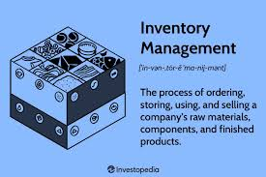
Inventory Management System
Presented By:
Suvesh (168)
Gun Chugh(169)
Pallavi Jain (170)
Arihant Jain(171)

Slide 2
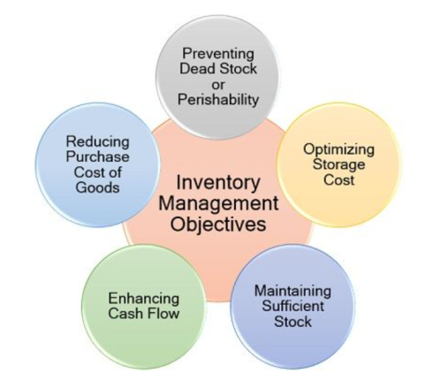
Overview and Purpose:
This project is a Chip Inventory Management System developed in C++ using file handling. It allows users to manage chip products by storing all data in a simple csv file, eliminating the complexity of database setup. The project provides functionalities such as adding new products, searching, editing, deleting records, displaying all available products, and generating bills with applicable taxes and discounts. It is designed as a console-based application with a menu-driven interface to facilitate easy navigation and interaction. The system aims to offer a lightweight, portable inventory management solution suitable for small businesses or learning purposes.

Slide 3
Key Features and Data Handling
The program uses C++ standard file input/output to read and write product data from a CSV file. Each chip product's details, including Product ID, Name, Quantity, Seller, Price, Brand, and Deadstock, are stored as structured data in memory during runtime and saved back to the file upon modification. Users can perform CRUD (Create, Read, Update, Delete) operations on inventory items, ensuring real-time data persistence. The billing feature computes GST and discounts based on predefined slabs and outputs a detailed bill summary. This approach emphasizes simplicity, eliminating the need for external dependencies while maintaining core inventory management functionalities.

Slide 4
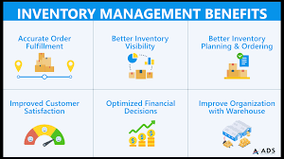
Benefits and Future Scope
This file-based inventory system provides a foundation for understanding inventory management concepts and file handling in C++. It is accessible for users without database expertise and portable across different environments. The proposed design focuses on ease of use, reliability, and modularity to allow future enhancements, such as integrating GUI frontends, advanced reporting, or migrating to database-backed storage. With minimal setup required, this project serves as an educational tool and a stepping stone for building more complex inventory or retail systems in C++.

Slide 5
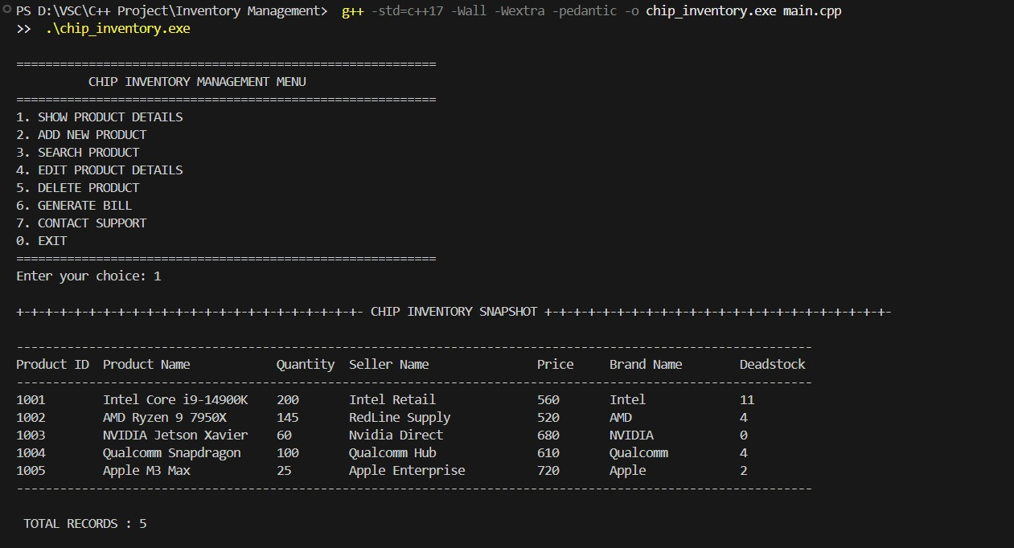

Slide 6
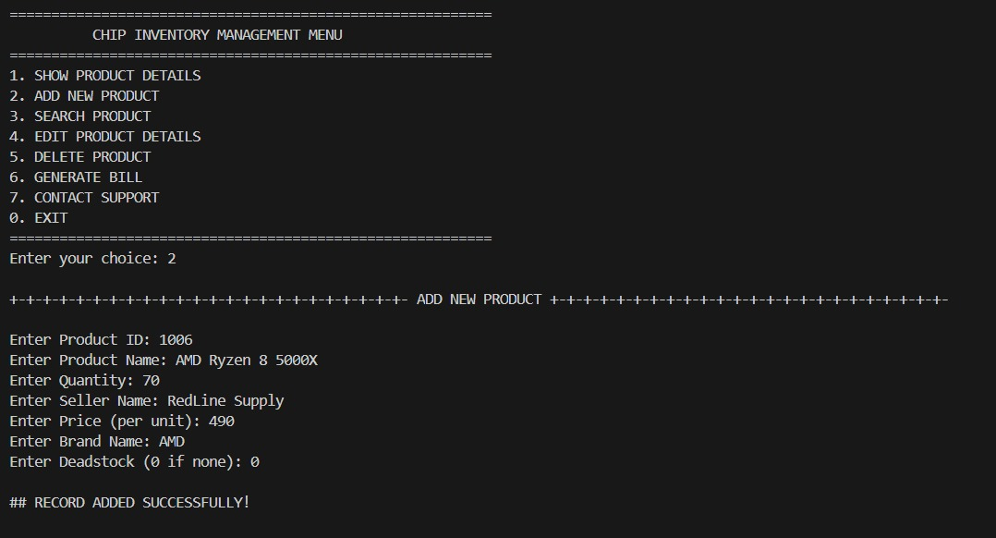

Slide 7
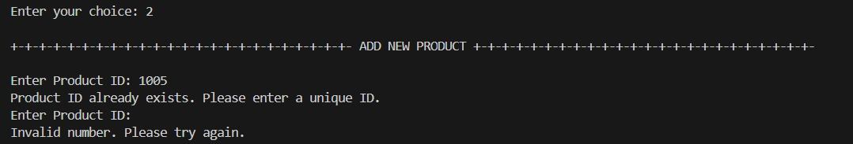

Slide 8
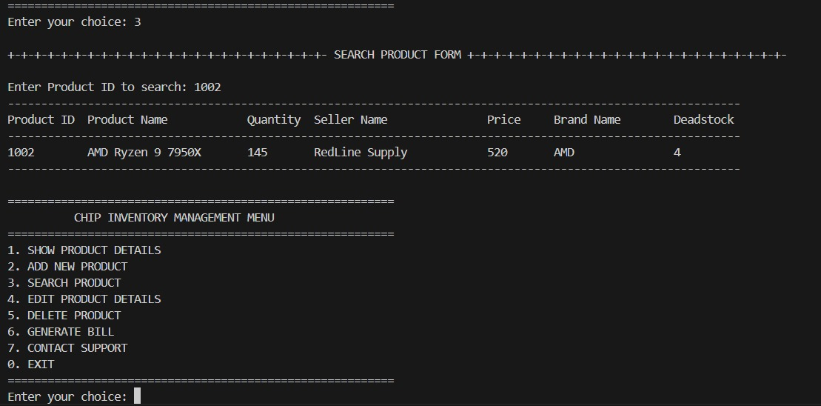

Slide 9
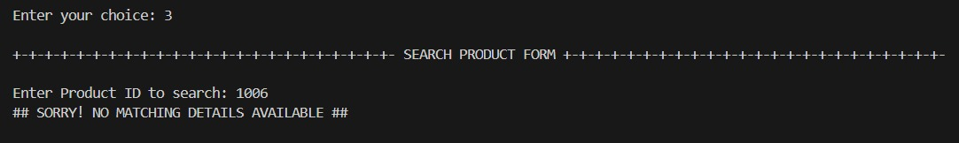

Slide 10
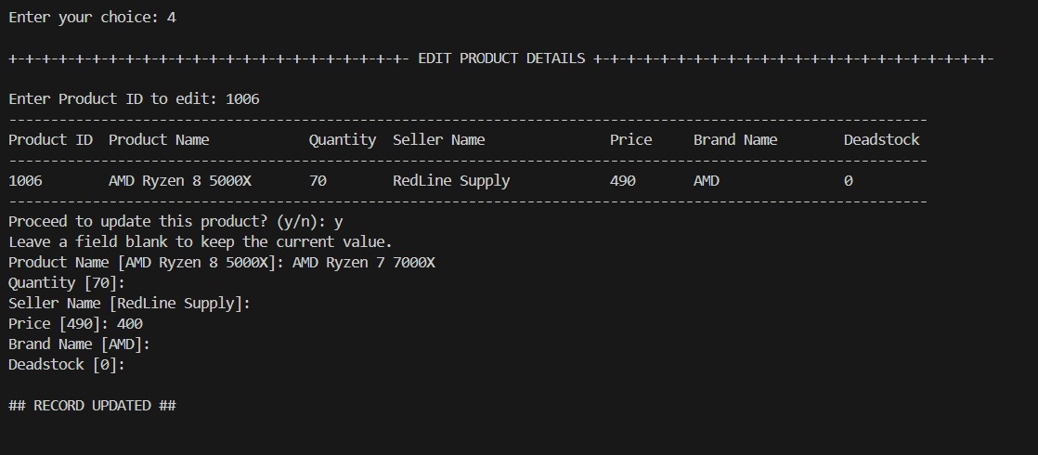

Slide 11
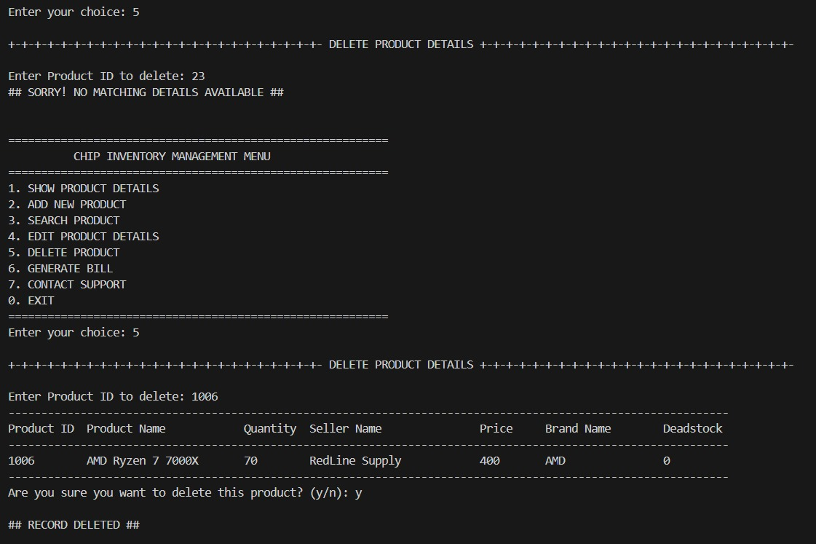

Slide 12
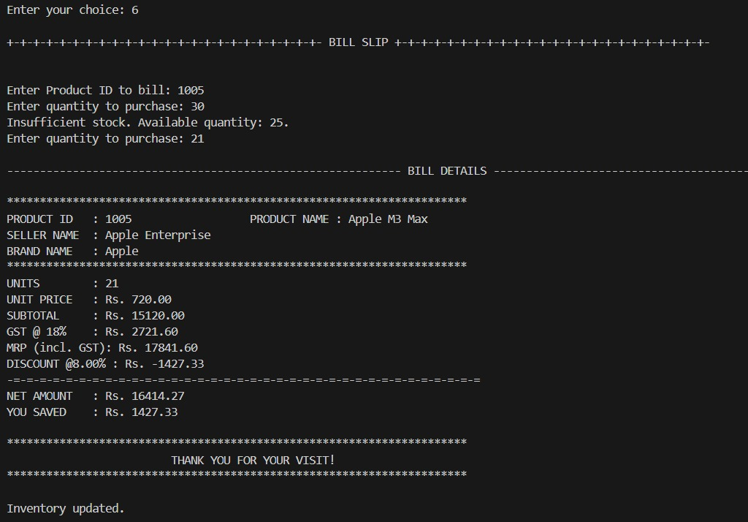

Slide 13
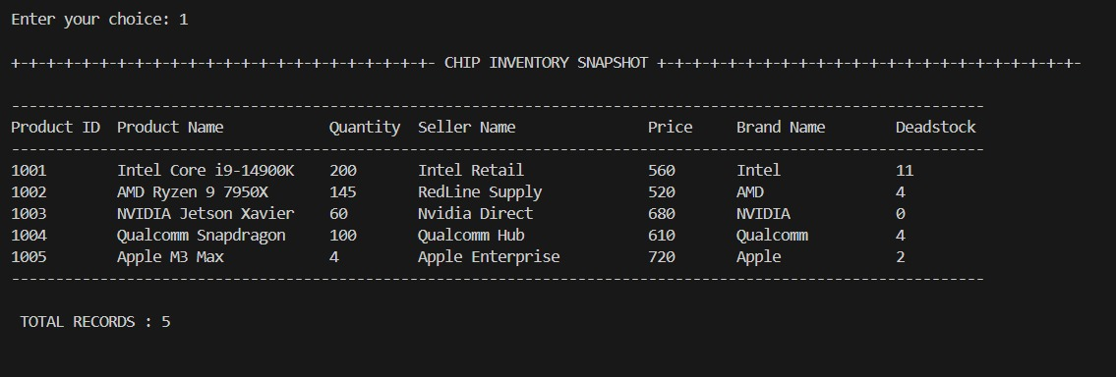

Slide 14
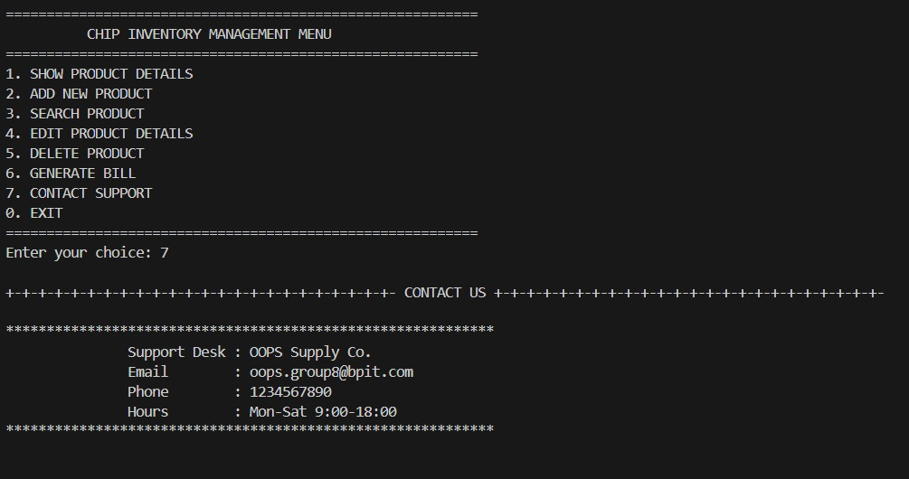

Slide 15
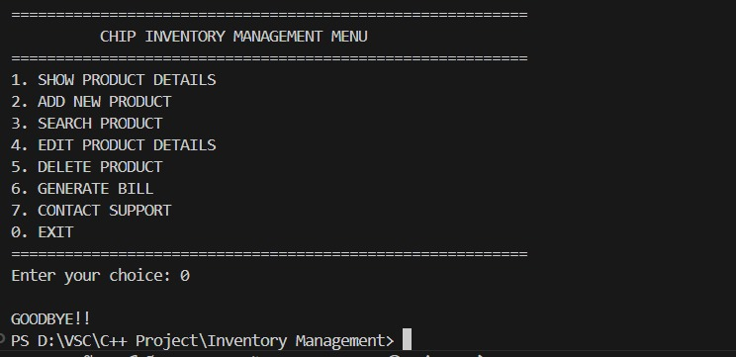

Slide 16
Thank You!

